Slide 1
Entering Transmittal Sheet By Supervisors

Slide 2
Why a transmittal sheet exists?

Slide 3
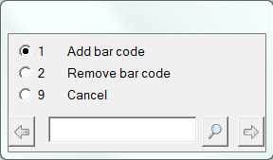
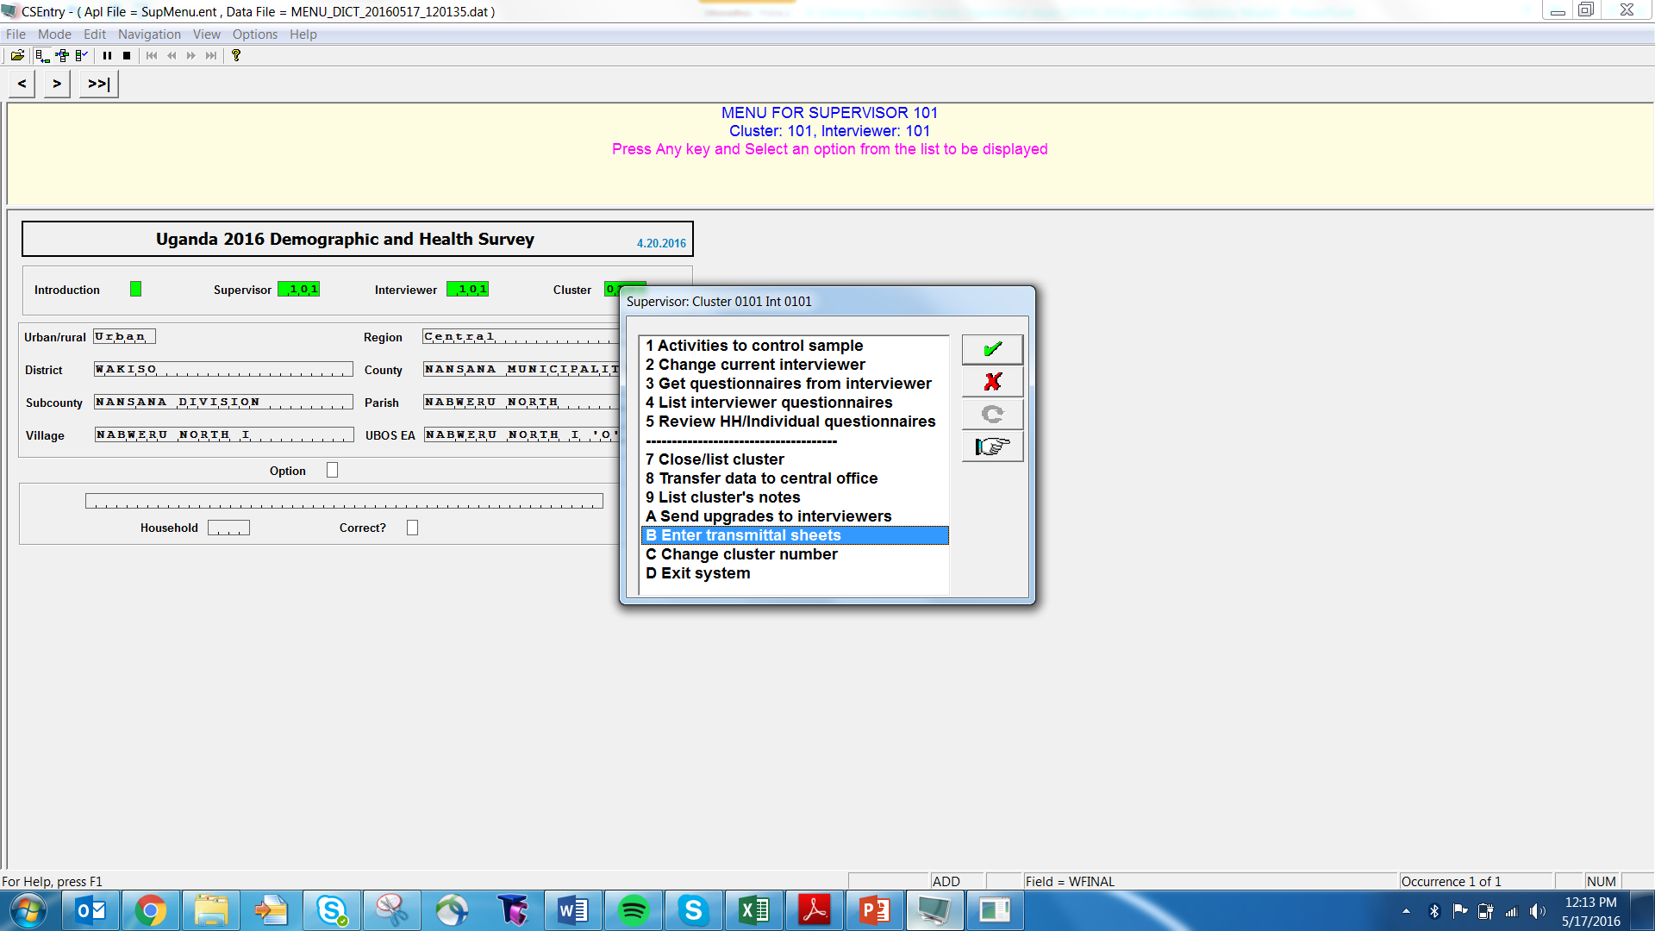
Navigate to Transmittal Sheet
From data manager tablet, choose option B.
Choose whether to add barcodes, remove any incorrect barcodes, or exit the system.

Slide 4

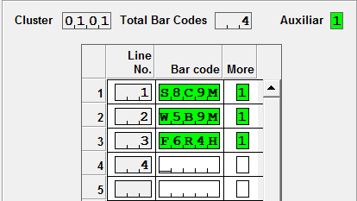

Adding barcodes
Must choose option 1 – Add barcode – each time.
Or use a scanner!
Tips for entering:
Letter, number, letter, number, letter
Be careful with O vs. 0; I vs. 1

Slide 5
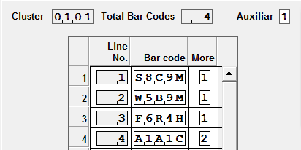
Adding barcodes
If more barcodes, choose YES.
If not more barcodes, be sure to choose NO.
Check barcodes –
make sure they match transmittal sheet!
Notes:
If no more, but enter yes, then a blank gets added to the data file and must be removed.

Slide 6
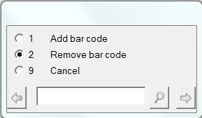
Removing barcodes
If there is a blank barcode in the data file OR an extra barcode that must be removed…
Notes:
If no more, but enter yes, then a blank gets added to the data file and must be removed.

Slide 7
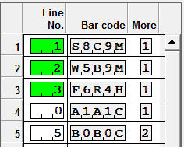
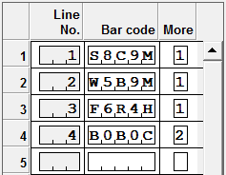
Removing barcodes
Notes:
If no more, but enter yes, then a blank gets added to the data file and must be removed.

